Slide 1
An Introduction to MBT
⎯ what, why and when
张 坚
26/11/8

Slide 2
The Challenge

Slide 3


The Challenge
Koi Carp
  Employ amateur fishermen
  Place nets at strategic places
  Electrofishing boat

Slide 4
The Challenge
Testing a new smart card payment system
  Manual design/perform tests
  Manual design tests + use automated test execution tools
  Use state-of-the-art tools:
    Automatically generate tests from a model of your requirements
    Regenerate updated test suites each time the requirements change
    Exactly report the coverage of requirements

Slide 5
The Challenge
Benefits of the third solution
  Get faster results with lower costs
  Ensure a more systematic coverage
Model-Based Testing

Slide 6
What Do We Mean by Testing?
Testing is an activity performed for evaluating product quality, and for improving it, by identifying defects and problems
⎯ IEEE Software Engineering Body of Knowledge 2004
Software testing consists of the dynamic verification of the behavior of a program on a finite set of test cases, suitably selected from the usually infinite executions domain, against the expected behavior

Slide 7
What Do We Mean by Testing?
Dynamic
  Static techniques: inspections, static analysis
Finite
  Exhaustive testing is impossible
Selected
  Key challenge of testing
Expected
  Oracle problem

Slide 8
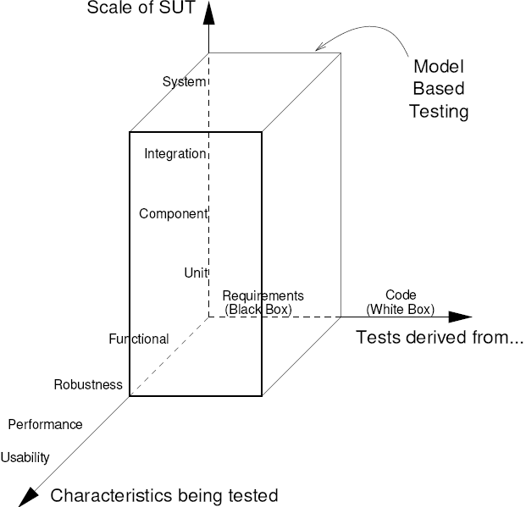
What Do We Mean by Testing?
Different kinds of testing

Slide 9
What is Model-Based Testing?
Four main approaches known as MBT
  Generation of test input data from a domain model
  Generation of test cases from an environment model
  Generation of test cases with oracles from a behavior model
  Generation of test scripts from abstract tests

Slide 10
What is Model-Based Testing?
Generation of test input data from a domain model
  The model is the information about the domains of the input values
  The test generation involves clever selection and combination of a subset of those values to produce test input data
No oracles
A: {red, greem, yellow}, B: 1..4, C: {car, truck, bike}
All possible combinations: 3*4*3 = 36 tests
Pairwise algorithm: 12 tests

Slide 11
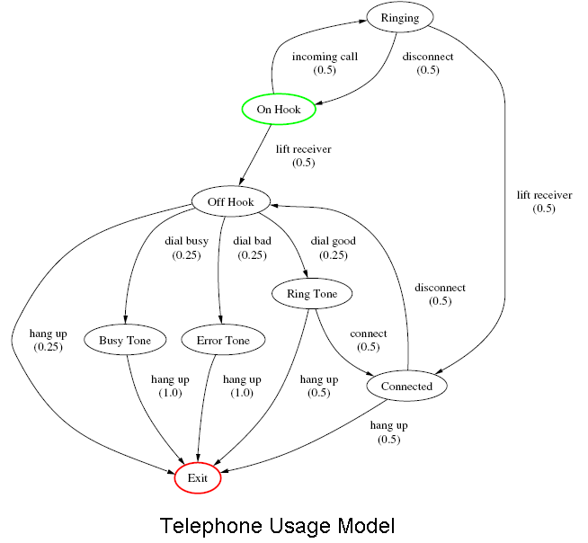
What is Model-Based Testing?
Generation of test cases from an environment model
  The model is the expected environment of SUT
    A statistical model of the expected usage of SUT
  Generate sequences of calls to SUT from them
No oracles

Slide 12
What is Model-Based Testing?
Generation of test cases with oracles from a behavior model
  The model must describe the expected behavior of SUT
  The only one that addresses the whole test design problem

Slide 13
What is Model-Based Testing?
Generation of test scripts from abstract tests
  An abstract description of a test case
    A UML Sequence diagram
    A sequence of high-level procedure calls
  The model is the information about the API of SUT and the details of transformation

Slide 14
What is Model-Based Testing?
Definition
  Create a model of the expected SUT behavior
  Generate tests from that model
The automation of the design of black-box tests

Slide 15
What is Model-Based Testing?
What is a model?
  Small
  Detailed enough
Tradeoff: which characteristics of the system should be modeled?

Slide 16
What is Model-Based Testing?
What notation should we use to write models?
  State-based notations
    B, UML/OCL, Spec#
  Transition-based notations
    FSM, UML State Machines
  ……

Slide 17
What is Model-Based Testing?
Summary
  MBT is the automation of black-box test design
  The model must be concise and precise
  Test cases (test data + oracles) can be automatically generated from the model
  The tests produced from the model are abstract tests, so they must be transformed into executable tests

Slide 18
The Pain and the Gain

Slide 19
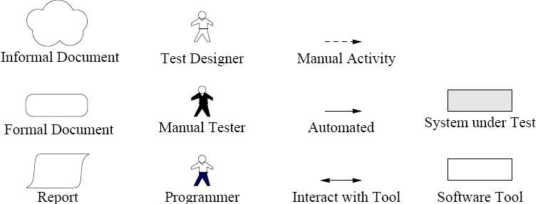
Classic Testing Process
Three key issues
  Design the test cases
  Execute the tests and analyzing the results
  Verify how the tests cover the requirements
The notations

Slide 20
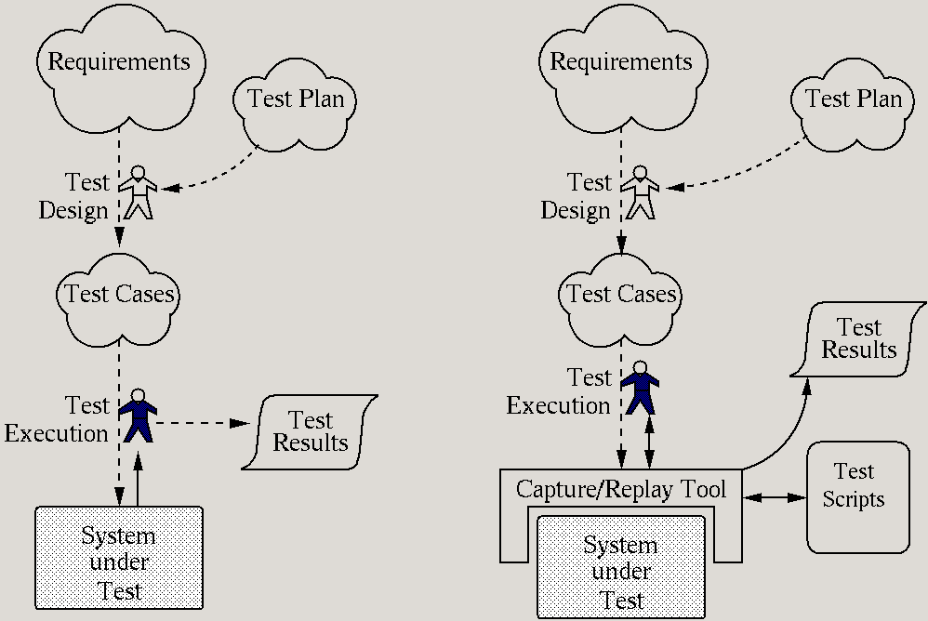
A Manual Testing Process
+ easy & cheap to start
+ flexible testing
expensive every execution
no auto regression testing
ad-hoc coverage
no coverage measurement

Slide 21
A Capture-Replay Testing Process
+ flexible testing
+ auto regression testing
expensive first execution
- fragile tests break easily
ad-hoc coverage
no coverage measurement

Slide 22
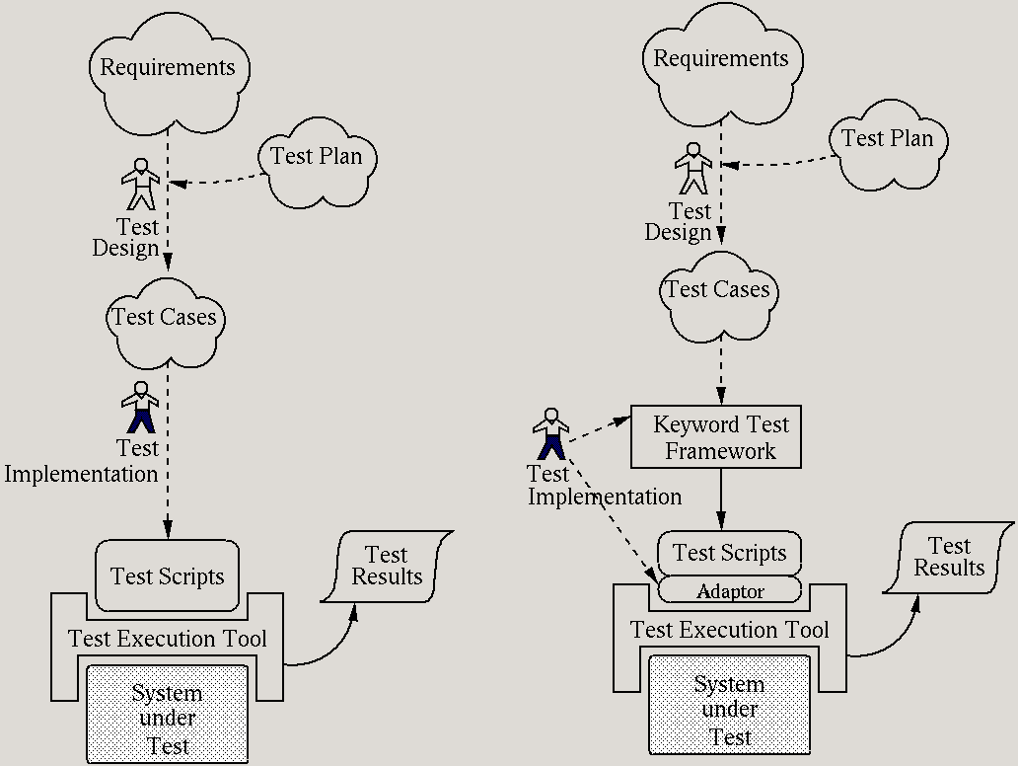
A Script-Based Testing Process
+/- test impl. = programming
+ automatic execution
+ auto regression testing
fragile tests break easily?
(depends on abstraction)
ad-hoc coverage
no coverage measurement

Slide 23
A Keyword-Driven Testing Process
+ abstract tests
+ automatic execution
+ auto regression testing
ad-hoc coverage
no coverage measurement

Slide 24
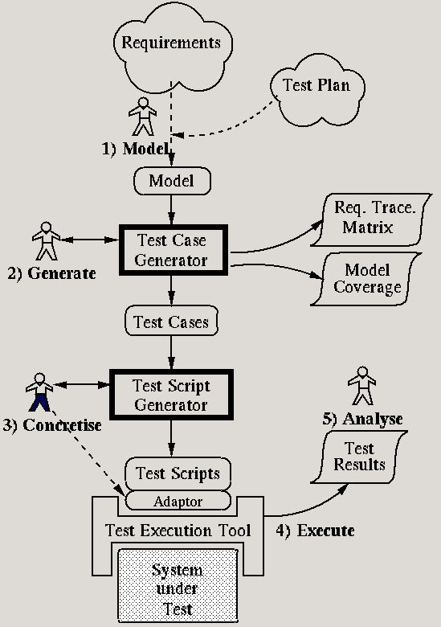
The Model-Based Testing Process
+ abstract tests
+ automatic execution
+ auto regression testing
+ auto design of tests
+ systematic coverage
+ measure coverage of model and requirements
- modeling overhead

Slide 25
Models: Build or Borrow?
A good model is essential
Reuse the development model?
  Often a very bad idea ☹
  Not abstract enough
  Not precise enough
  Lack of independence
Develop a test model from scratch?
A middle path?
  Reuse a high-level class diagram

Slide 26
Your Modeling Maturity Level
UML/OCL and MDA community
  Level 0, No Specifications
  Level 1, Textual
  Level 2, Test with Diagrams
  Level 3, Models with Text
  Level 4, Precise Models
  Level 5, Models Only
Model-Based Testing

Slide 27
Model-Based Testing Experience Reports
Model-Based Testing at IBM
  GOTCHA-TCBeans + TCtranslator
    POSIX fcntl:
      +2 defects
      -17% cost
    Java garbage collor:
      +4 defects
      Statement coverage: 78% → 83%
      -50% time spent

Slide 28
Model-Based Testing Experience Reports
Model-Based Testing at Microsoft
  Spec#/Spec Explorer
    An interaction protocol of Windows
      Discover 10 times more errors
      Code coverage: 60% → 70%
      Expose twice as many design issues as implementation bugs

Slide 29
Benefits of Model-Based Testing
SUT Fault Detection
  >= the manual process
  Depend on the skill and experience
Reduced Testing Cost and Time
  Less time and effort
Improved Test Quality
  Based on algorithms and heuristics
  Measure the quality by the coverage of model

Slide 30
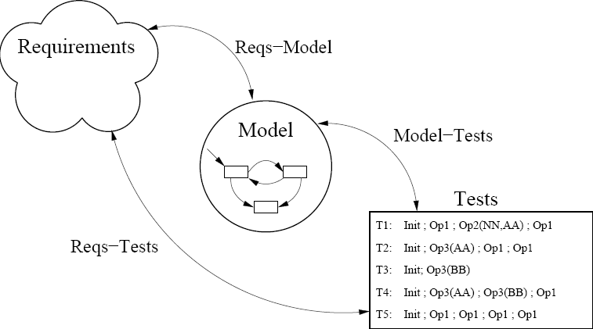
Benefits of Model-Based Testing
Requirements Defect Detection
  The model has a precise semantics
  Expose issues in the informal requirements
Traceability
  Requirements-Model
    Annotate the model elements with requirement IDs
  Model-Tests
  Requirements-Tests

Slide 31
Benefits of Model-Based Testing
Requirements Evolution
  Take less time to update
  Incremental traceability
    Deleted
    Unchanged
    Changed
    Added

Slide 32
Limitations of Model-Based Testing
Cannot guarantee to find all the differences between the model and the implementation
It requires different skills from manual test design
  Modeling skills and programming skills
Usually used only for functional testing
Require a reasonable level of test maturity

Slide 33
Putting It into Practice

Slide 34
Prerequisites for Model-Based Testing
Someone enthusiastic
Test execution maturity
Modeling skills
  The models for MBT are more precise than most UML models
Access to training, tools, and experts
  No independent training companies
The right kind of application

Slide 35
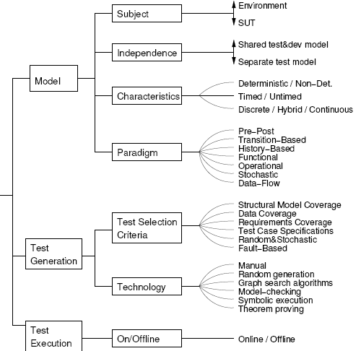
Selecting A Model-Based Testing Approach

Slide 36
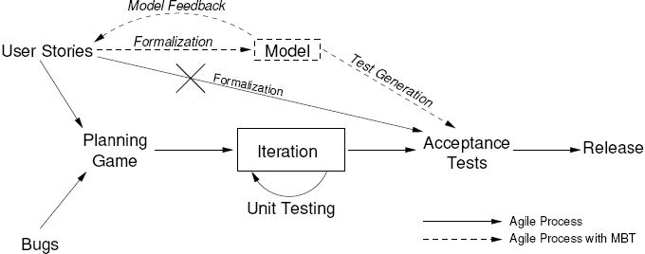
Model-Based Testing and Agile Methods

Slide 37
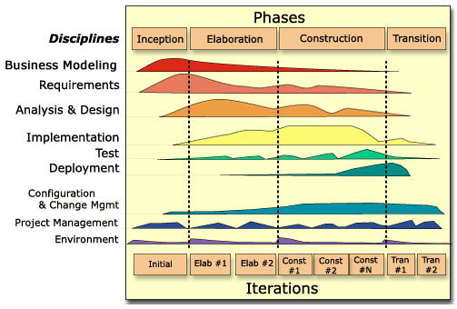
Model-Based Testing and the Unified Process (UP)
UP

Slide 38
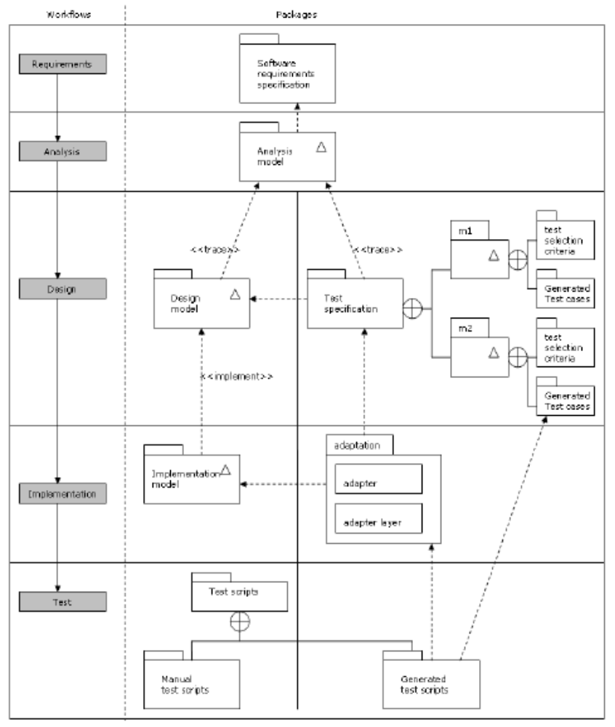
Model-Based Testing and the Unified Process (UP)
Combine UP
and MBT

Slide 39
Future Trends
Three major trends make the increased adoption of Model-Based Testing
  Increasing level of complexity in modern software
  Increasing demand for software with high quality
  Increasing use of models in software development
Expand into other kinds of testing
More good studies that quantitatively measure the benefits and drawbacks of adopting MBT

Slide 40
Thanks

